Slide 1
Virtual Job Fair v5.0
Final Presentation
Rogelio Alonso
Notes:
Hello and welcome.
Thank you for attending my final presentation.
My name is Rogelio Alonso and I will presenting Virtual job Fair version5.0
A little of motivation, Virtual Job Fair is a web system that provide student with thousands of job visibility, and employer with the opportunity to tap talent at universities.

Slide 2
Acknowledgment
VJF 4.0 (FA 14)
VJF 3.0 (SU 14)
VJF 2.0 (FA 13)
VJF 1.0 (SP 13)
Erick Arenas
Artiom Tiurim
Ana L. Hernandez
Manuel Bouza
Enio Peña Navarro
Tomas Acosta
Luis Irizarry
Luis Benjumea
Jorge Fernandez
Justin Korah
Diego Perez
Andres Gonzalez
Enmanuel Corvo
Tomer Doar
Notes:
Before I continue, I would like to give credit to previous version members, I wish I have time to over all the names.

Slide 3
Special Acknowledgement
Mentor:
Juan Caraballo, IBM & FIU, as Industry Advisor
Mentor and Instructor:
Ph.D. Masoud Sadjadi, FIU, as Associate Professor
Notes:
I would like to mention my mentors, Juan Caraballo and Masoud Sadjadi.

Slide 4
Problem Definition
Employers geographical barriers
Employers unable to seek for talent in multiple locations
Students inability showcase especial skills, experience and talents via emails
Students and Employers are not able to connect in real time.
Notes:
This system started as a solution to the inability of employers to tap local talent at job fairs and universities due to geographical barriers. Also, employers don’t have the economic capabilities to recruit in multiples locations at the same time. Also, for the student inability to showcase skill and talents via email and not being able to connect with potential employer in real time.

Slide 5
System Limitations
Employer registration
No guests access to the system
Job posting limited to registered employers
Inability to students to replace old video and PDF resumes
Students search for job is not 100% accurate
The system does not count with a way to test for regression errors
Notes:
Version 4.0 had the following limitations:
Employer not able to fully access the system until access was granted by a system admin
No access to the system for guest
And job postings can only be placed by registered employers
We had the inability to replace your video and PDF resume
The job search is not 100% accurate
The system does not count with a regression test scrip

Slide 6
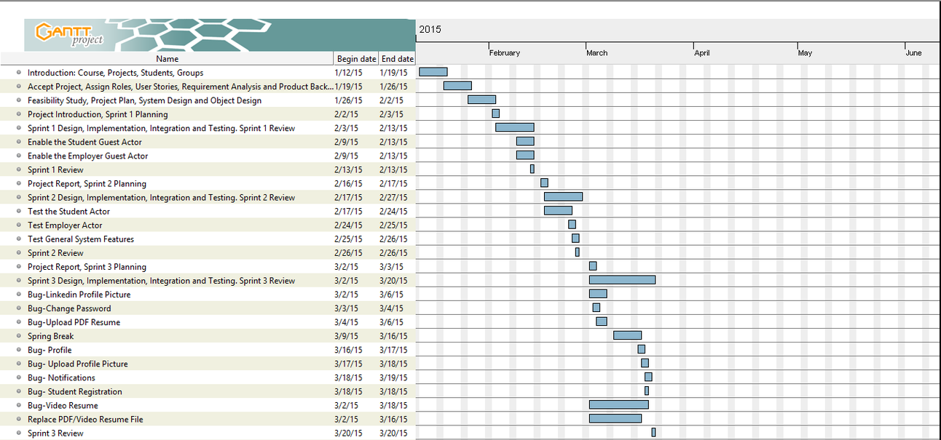
Gantt Chart
Notes:
This a portion of my Gantt chart for this term, where I’ve listed all the users stories I’ve worked on.

Slide 7
Main User Stories
Enable Guests Employer/Student account and provide limited functionality.
Test the Student/Employer Actors User Stories and System General Feature.
Replace PDF and Video Resume.
Feasibility Study for a search engine.
Solr Search Server Set Up and Configuration.
Solr Indexing of MySQL Database.
Notes:
On the first sprint I enable two new actors to the system, the guest Employer and Guest Student and gave them limited functionality.
I also tested the Student/employer actor user stories and created and automated test script that can be used in regression testing.
Allowed the Student to replace Video and PDF resume files.
Created a feasibility study for a search engine
And, in the last sprint Installed and configured Solr search engine and created an schema to index MySQL tables.

Slide 8
Stability Fixes
Search and Advance Search for Jobs.
Change Password.
Upload PDF/Video Resume.
Edit Profile Basic Info.
Linked In Profile Picture.
Students Notifications.
Student Registration.
Replace Profile Picture.
Delete User by Admin.
Send/Receive/Delete Messages.
Register Button for Student/Employer Users.
Post Job Button for the Employer Users.
Indeed and StackOverFlow API’s.

Slide 9
Use Case for Replace Video Resume
Use Case ID | VJF-078 Replace Video Resume
Description | Allows student actor to replace his/her video resume.
User Story #392 | As a Student I would like to see my video resume from my profile page and be able to upload a more updated one. This will benefit me as I will be able to reassure that I have uploaded a file with my resume, and it will allow me to have the most recent copy by replacing the old one.
Actor | Student
Pre-conditions | Actor is logged in. Actor is in his/her profile page. Actor has a video resume to upload to the system.
Steps | Use case begins when the actor clicks on the update resume button. System displays a windows to select the file to be uploaded. Actor selects his/her resume file and click open. System stores the video resume and updates its path on the database. Systems displays the upload was successful.
Post-conditions | Actor update his/her video resume file.
Alternative Steps | From step 4 the file cannot be uploaded or the path inserted in the database. System displays the upload had an error.
Exceptions | Invalid file format. Invalid file extension. No file selected

Slide 10
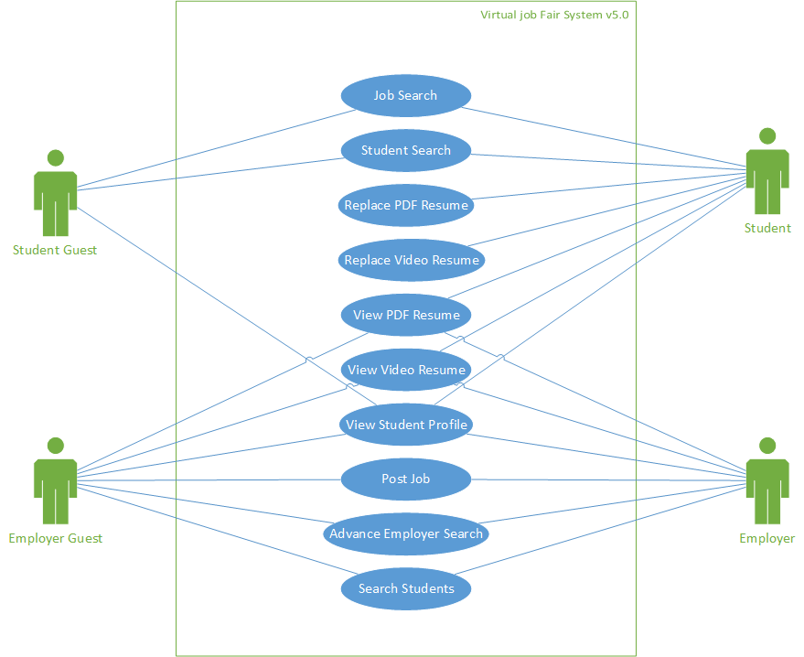
Use Case Diagram

Slide 11
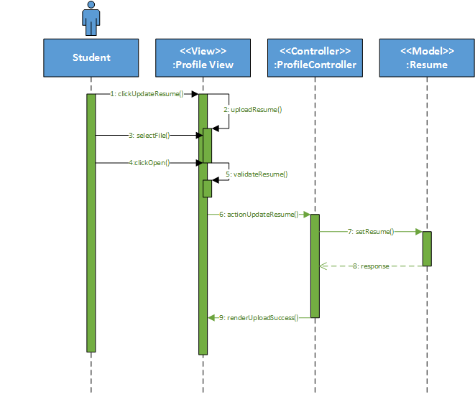
Sequence Diagram for Replace Video Resume

Slide 12

System Architecture
Yii Router
1-HTTP Request
7-HTML
2-Action
5-Invoke
3-Call
View
Controller
Model
6-HTML
4-Send Content

Slide 13
System Decomposition
Screen Share Subsystem
Whiteboard Subsystem
Video Interview Subsystem
E-mail Message Subsystem
Notification Subsystem
Automated Notification Subsystem
SMS message subsystem
Student Profile Subsystem
Merge Account Subsystem
Linking Account Subsystem
Student Job Match Subsystem
Search Subsystem
API Subsystem

Slide 14
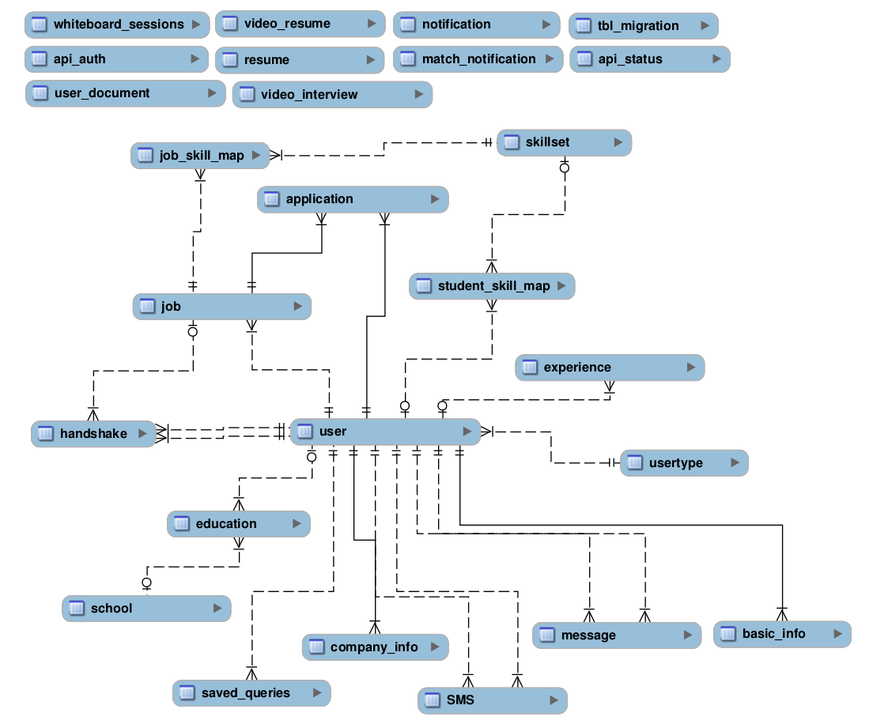
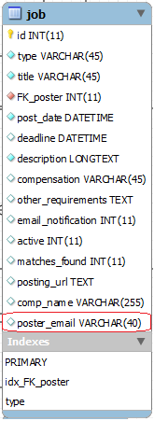
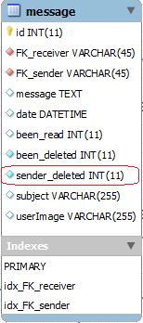
Persistent Data

Slide 15
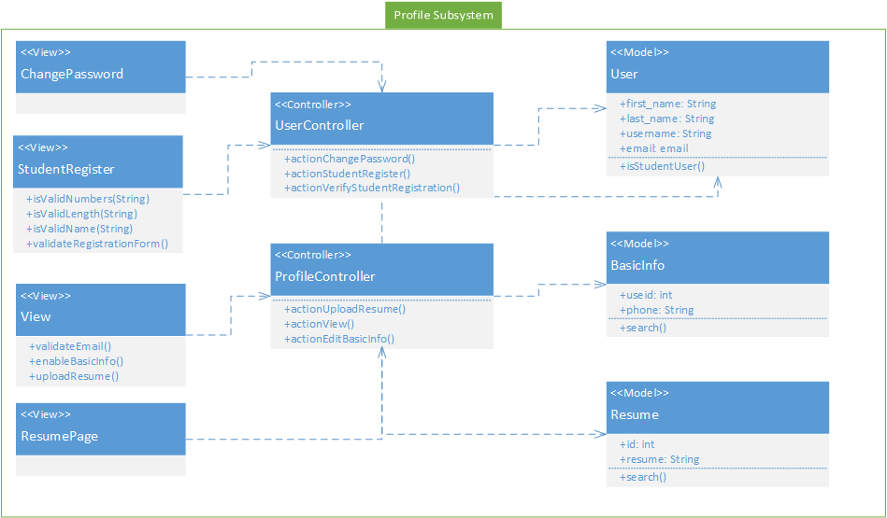
Class Diagram for Profile Subsystem

Slide 16
Algorithm used to Replace a Video Resume
JavaScript File Verification (Client Side)
Upload the File
PHP Validation (Back End)
Delete Previous Resume (if any)
Change the Video File Name to Match the Student User.
Update the Model

Slide 17
Test Cases for Replace Video Resume
Sunny Day Test Case
Rainy Day Test Case
Test Case ID | VJF-022-Replace-Video-Resume
Purpose | To validate use case VJF-078 Replace Video Resume, with a valid Video Resume file and format.
Preconditions | User is in his/her profile page
Inputs(s) | User presses Upload Video Resume button. User select a video resume file from his/her PC. User clicks Select button.
Expected Result | System displays profile page with Resume link enabled.
Test Case ID | VJF-023-Replace-Video-Resume-Wrong-Format
Purpose | To validate use case VJF-078 Replace Video Resume, with ab invalid Video Resume file and format.
Preconditions | User is in his/her profile page
Inputs(s) | User presses Upload Video Resume button. User select a file from his/her PC. User clicks Select button.
Expected Result | System displays “Video Resume must be in mov or mp4 format”

Slide 18
Additional Test Cases
Student Registration – 15 Test Cases
Student Login – 18 Test Cases
Employer Login – 2 Test Cases
Student Change Password – 2 Test Cases
Student Password Recovery – 2 Test Cases
Student Save Query – 2 Test Cases
Student Activate/Deactivate Save Query – 4 Test Cases
Student Upload PDF Resume – 2 Test Cases
Student Upload PDF Resume – 2 Test Cases
Student Upload Picture – 2 Test Cases
Student Change Skill Order – 2 Test Cases
Student Profile – 2 Test Cases
Student Job Search – 12 Test Cases
Student/Employer View Message – 2 Test Cases
Student/Employer Receive Message – 2 Test Cases
Student/Employer Reply Message – 2 Test Cases
Student Disable Looking for Jobs – 2 Test Cases
Student Receive Job Notification – 2 Test Cases
Student SMS Verifications – 2 Test Cases
Student Read Notification – 2 Test Cases
Total Test Cases: 83

Slide 19
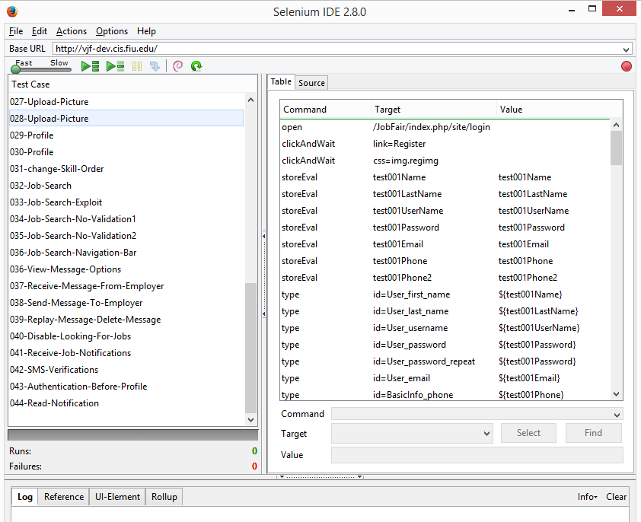
Automated Test Suite

Slide 20
Thanks for being a wonderful audience.

